Slide 1
AFIT Building 470 Graphite Pile
Foil Activation
NENG 612 – Summer 2018
Captain Amy Hall
Air Force Institute of Technology
16 Aug 2018

Slide 2
Project Overview
Project introduction
Original research plan
HPGe energy and efficiency calibration
Foil Activation
Research difficulties
Updated research plan
Overview of post-processing and STASYL

Slide 3
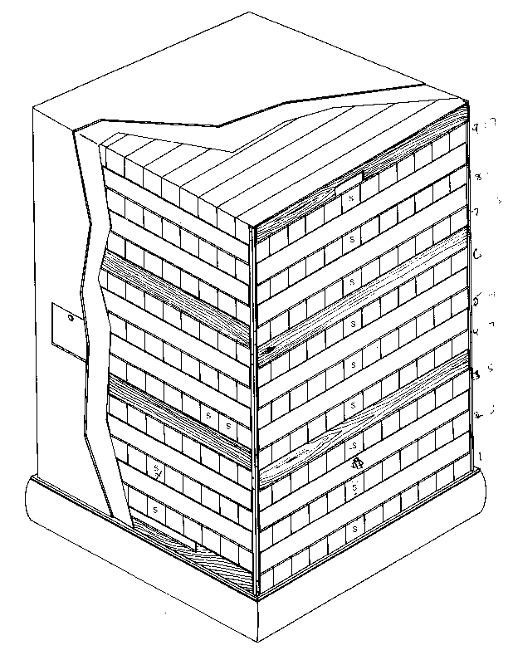
Project Introduction
The goal of this project is to measure the neutron energy spectrum of the AFIT graphite pile with PuBe source
A secondary goal that pertains to my thesis project is to perform a foil activation and become familiar with the associated post-processing
Graphite Pile
PuBe Source
Foils in Stringer 2
Notes:
The secondary goal pertains to my thesis project because I will be doing a foil activation analysis on the proton and deuteron beam at MURR to measure their energy

Slide 4
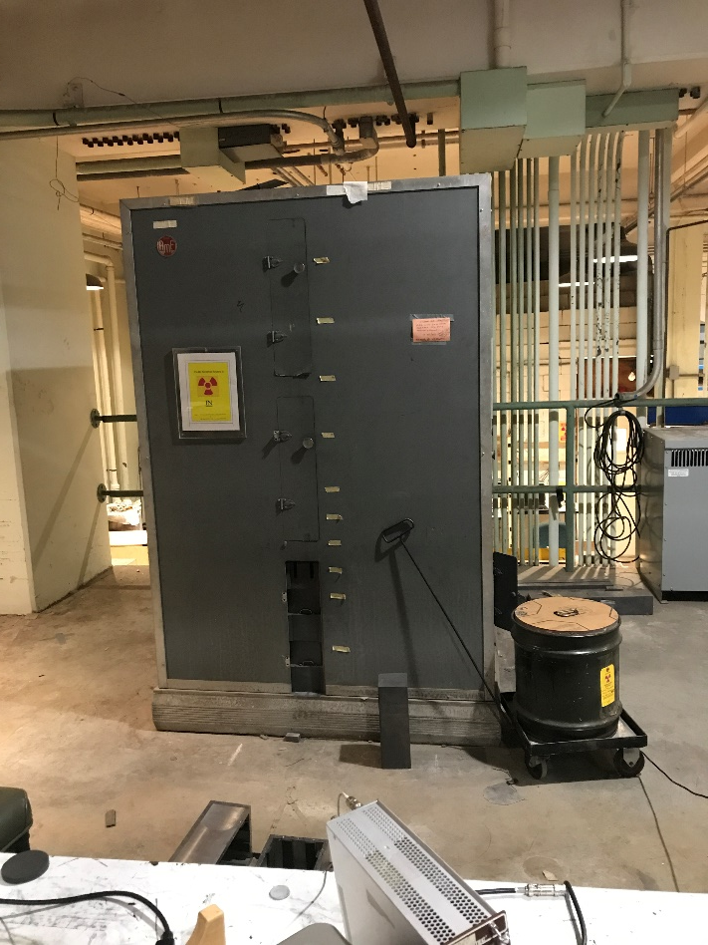
Research Plan
Stacked foils placed into stringer 2 of the graphite pile and irradiated
Irradiation set for 7 days, then increased to 10 days
Perform HPGe energy calibration and efficiency calculations
Foils counted on calibrated HPGe to determine their activity
Foil data used to unfold incident neutron spectra of graphite pile PuBe source using STAYSL
Notes:
Discuss the original research plan (will go into more detail on each component later on)

Slide 5
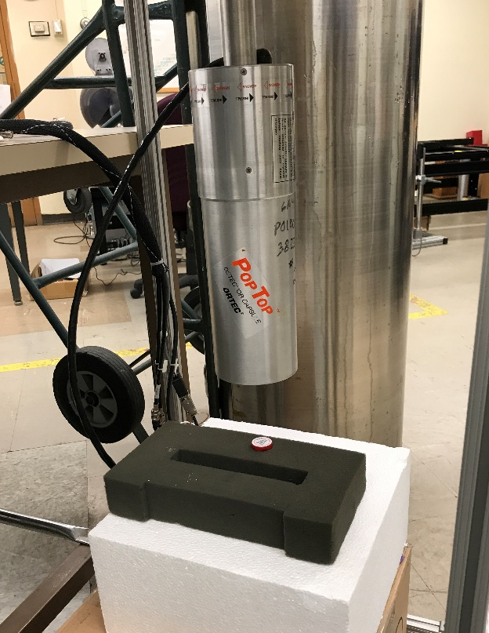
HPGe Energy Characterization
Multi-nuclide source at 4in from detector face measured with HPGe
The known peaks from the source were used to perform a detector energy calibration
Steps intended to complete:
Process repeated at a distance of 2in from the detector
Efficiency calculation
Measure foil activity and determine the neutron flux of pile
Notes:
HPGe detectors have excellent energy resolution when it comes to gamma ray spectropscopy
Could draw on board:
Where scintillators have oscillating energy peaks where peaks can’t be separated out easily, HPGes have sharp defined peaks
Energy calibration is done by calibrating peaks from a known sample (with known isotopes) to their corresponding known energies so then when unknown samples are measured, the detector is calibrated so the correct energy is measured for the unknown sample peaks
Efficiency calibration you have to take into account the distance from the detector, ideally it would be like a point source…

Slide 6
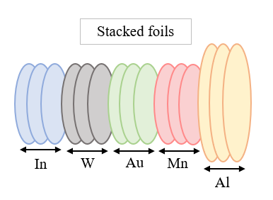
Neutron Foil Activation
A method of indirect neutron measurement
Neutrons from a source irradiate atomic nuclei of sample
Irradiation causes some nuclei to become radioactive
Gamma rays emitted from activated nuclei are measured
The gamma ray spectra can be unfolded in order to determine the neutron spectra
Notes:
In order to get an increased sensitivity for neutron measurements, materials for foils must be chosen that have large cross sections for neutron induced reactions
Foils used to keep thickness small to avoid perturbing the neutron flux in the foil

Slide 7
Research Difficulties
Energy calibration was completed based on 4in multi-nuclide source (run for ~2 days)
Started running the sample 2in from HPGe, then when we came back everything was broken…
None of the backup plans for measuring the foils were feasible (within course time constraints)
None of the HPGe detectors were working
LaBr and NaI – do not have sufficient gamma ray discrimination capabilities to practicably unfold spectrum under time constraints
Portable HPGe detectors had lower efficiency and unworkable storage constraints

Slide 8
Updated Research Plan
Data supplied by Capt. Bevins to replace lost foil activation data due to experimental issues
18cm source files for energy and efficiency calibrations
Analyze source data files to complete calibrations
Add calibrations into Peak Easy to use with foil data
Data from 4 different activation foils
Correction factor for foil activation data
Accounts for the foil activation measurements being at 1cm versus 18cm calibration data
Applied to numerator of activation equation
Notes:
we almost finished the first part, so pretend we finished and then do the post-processing
Peak easy, STAYSL, etc.
Honestly haven’t looked at the data yet because I’ve been working on this presentation and with the field trip and all

Slide 9
Post-Processing with STASYL
Software that allows for neutron activation rate analysis
Used to determine the neutron flux spectrum (least-squares approach) and covariance matrix
Spectrum unfolding through deconvolution
Pulse height spectrum from a detector is a convolution of detector response function and incident radiation
Unfolding complications can arise from uncertainty in detector inherent response function and from changes between calibration and measurement
Peaks identified and separated from each other to characterize the spectra
Notes:
uncertainty in detector inherent response function - some energies may not have experimental basis to compare to in order to validate

Slide 10
Conclusions
Gained familiarization with foil activation process, although unable to count foils post-irradiation
Better understanding of HPGe (and other) detectors through experimental issues that arose
Energy and efficiency calibrations with new data
Post-processing with Peak Easy and STAYSL on new data
Motivation and Goals met?
Unable to measure AFIT pile PuBe neutron source…
Overall, the integrity of the experiment will be maintained for the course objectives (gaining familiarization with the overall foil activation process and post-processing)
Notes:
Will still get to complete energy and efficiency calibrations with new data so not too much was lost (other than a lot of time and frustration… but still learned from that)
Post-processing to be completed next w/ STAYSL. Which is applicable and helpful for my thesis

Slide 11

Questions?
AFIT Building 470 Graphite Pile Foil Activation
Notes:
Great Barrier Reef – Cairns, Queensland, Australia

